Slide 1
Transmission for Offshore Wind in PJM:
Looking Ahead
Willett Kempton
Center for Research in Wind (CReW)
College of Earth, Ocean & Environment
Department of Electrical and Computer Engineering
University of Delaware
Elpiniki Apostolaki-Iosifidou
Grid Integration, Systems, and Mobility (GISMo)
SLAC National Accelerator Laboratory (Stanford University)
presented at
Energy Policy Roundtable in the PJM Footprint
Panel on Transmission for Offshore Wind
Philadelphia, 24 April 2019

Slide 2
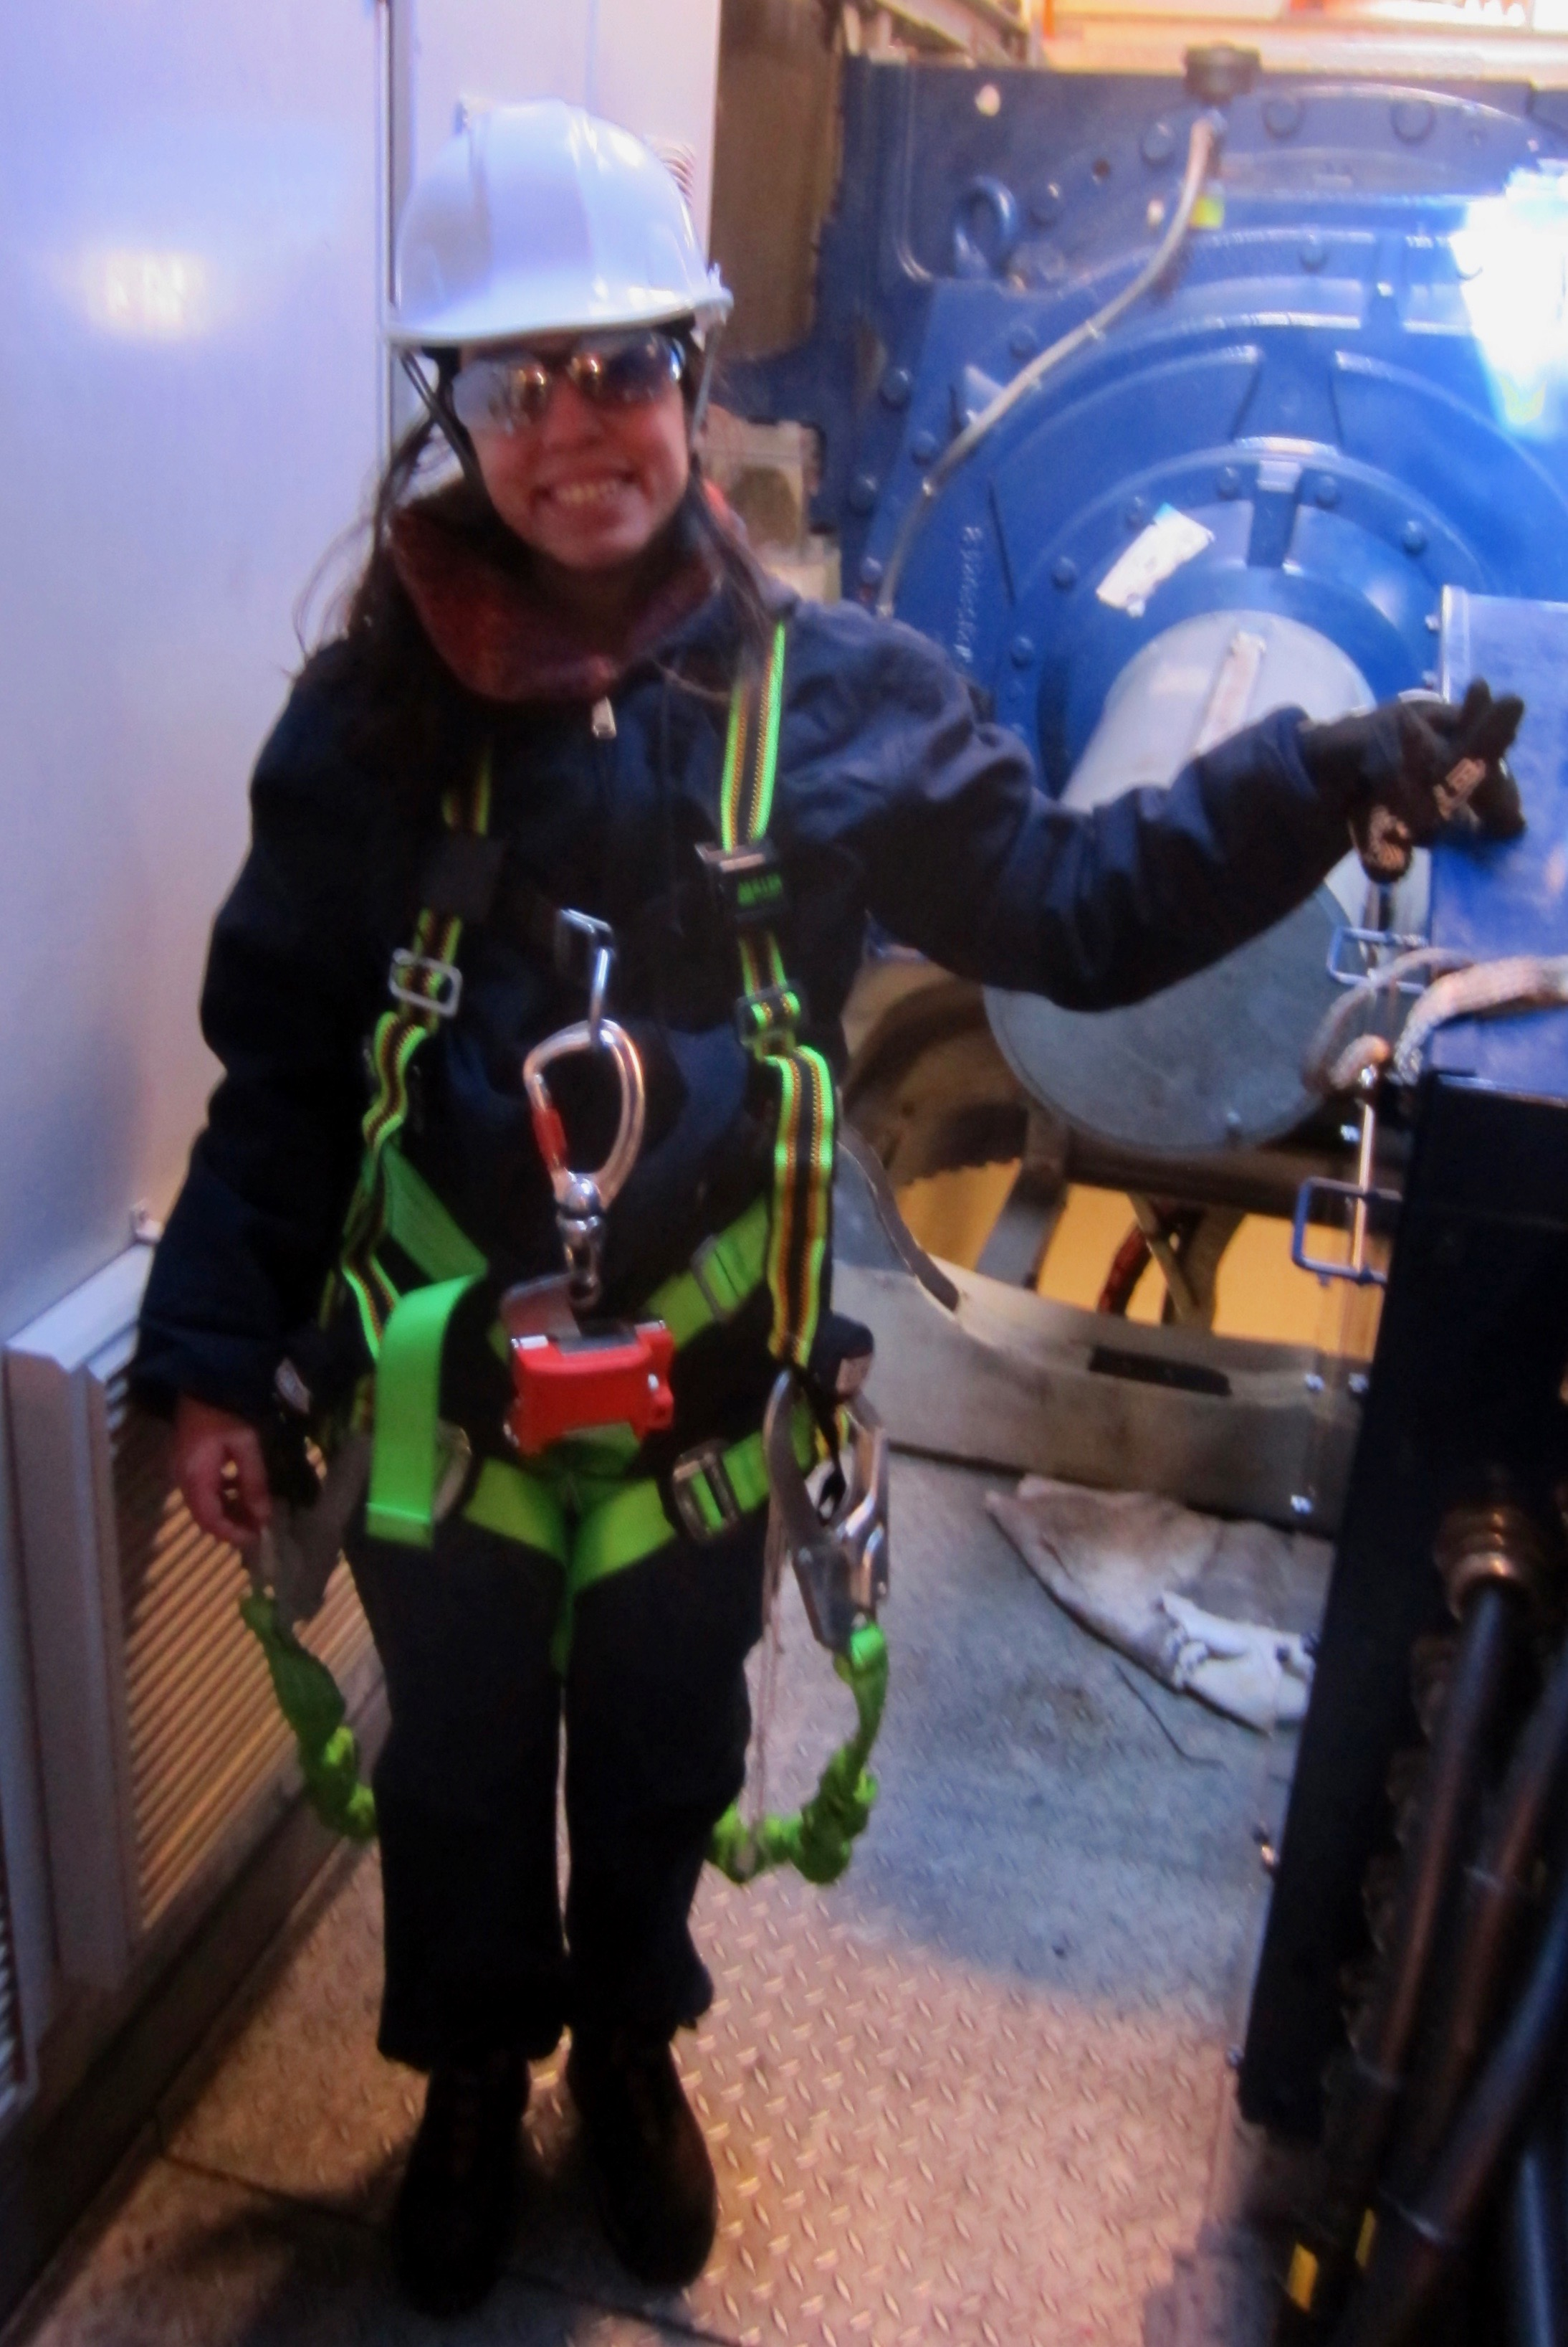
Right: Co-author
(in nacelle of UD’s Gamesa G90 Turbine)
Sources:
Elpiniki Apostolaki-Iosifidou, 2017, GRID INTEGRATION OF CLEAN ELECTRICITY GENERATION AND Storage, UD PhD in Electrical and Computer Engineering
ELPINIKI APOSTOLAKI-IOSIFIDOU, REGINA MCCORMACK, WILLETT KEMPTON, PAUL MCCOY, AND DENIZ OZKAN, 2019, Transmission Design and Analysis for Large-Scale Offshore Wind Energy Development, IEEE Power and Energy Technology Systems Journal, V 6 No 1, March 2019. DOI:10.1109/JPETS.2019.2898688
Simão, H.P., W. B. Powell, C. L. Archer, W. Kempton, 2017, The challenge of integrating offshore wind power in the U.S. electric grid. Part II: Simulation of electricity market operations. Renewable Energy, doi: 10.1016/j.renene.2016.11.049
Archer, C. L., H. P. Simão, W. Kempton, W. B. Powell, and M. J. Dvorak, 2017, The challenge of integrating offshore wind power in the U.S. electric grid. Part I: Wind forecast error. Renewable Energy, doi: 10.1016/j.renene.2016.11.047.

Slide 3
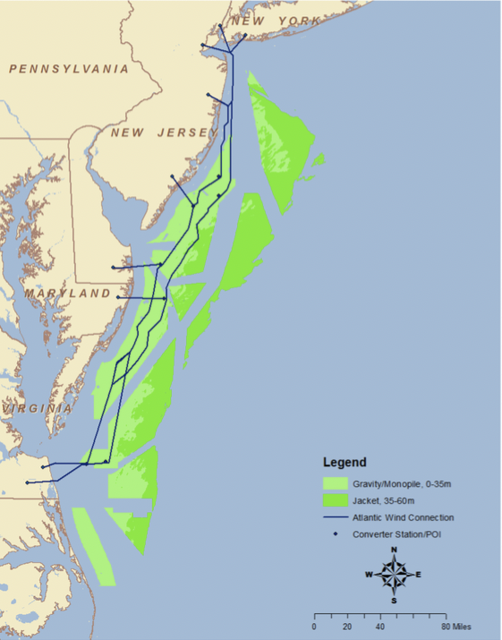
Offshore Wind Potential off PJM territory - 80 GW
Careful examination of wind, bathymetry, and all direct conflicts - image at right ( ≠ BOEM stakeholder process)
Only bottom-mounted, no floating wind
Result: 70 GW capacity off PJM states (Archer 2017, Apostolaki-Iosifidou 2019)
Image shows areas + one proposed HVDC system connecting to 9 POIs
Energy output at ~ 50% CF = 35 GWa
Question: How much is 70 GW?
Question: How to build transmission to get to shore?
Question: How to integrate so much variable generation?

Slide 4
How much OSW is 80 GW capacity?
At 50% CF, average OSW resource output = 40 GWa
PJM average load is ~85 - 90 GWa , PJM capacity is 184 GW, state OSW commitments are 4.7 GW (NJ 3.5 + MD 1.2 = 4.7 GW), so full PJM OSW resource is …
40/90 = 44% of avg PJM load, and
80/184 = 43% of PJM capacity
80/4.7 = 17 times PJM state commitments
PJM 2019 on-land wind generation: ~1 - 6 GW
So, all state OSW commitments would ~ double existing PJM wind generation
Average New Jersey load = 8.7 GWa
NJ’s commitment of 3.5 GW @ 50% CF would be 20% of NJ load

Slide 5
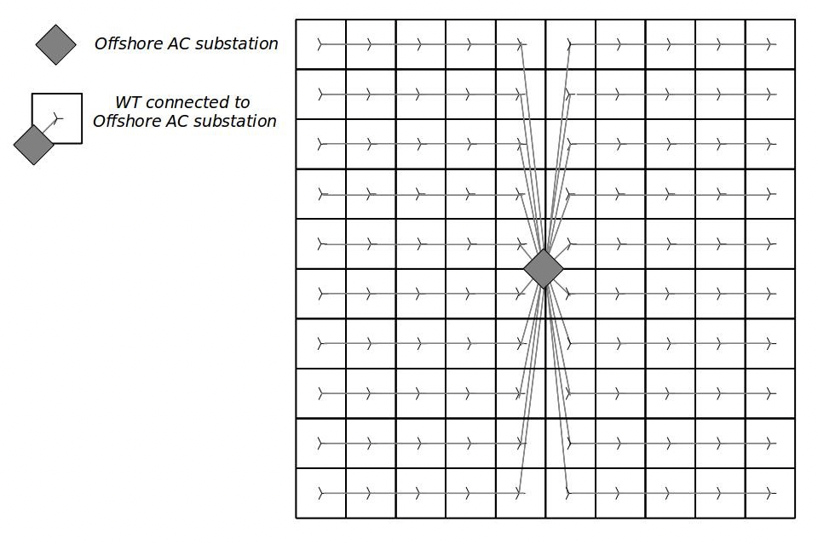
How to design a transmission system to bring 80 GW to shore?
Figure: Example layout of each 500 MW plant, with single substation in the middle.
160 wind plants @ 500 MW = 80 GW
APOSTOLAKI-IOSIFIDOU EtAl 2019

Slide 6
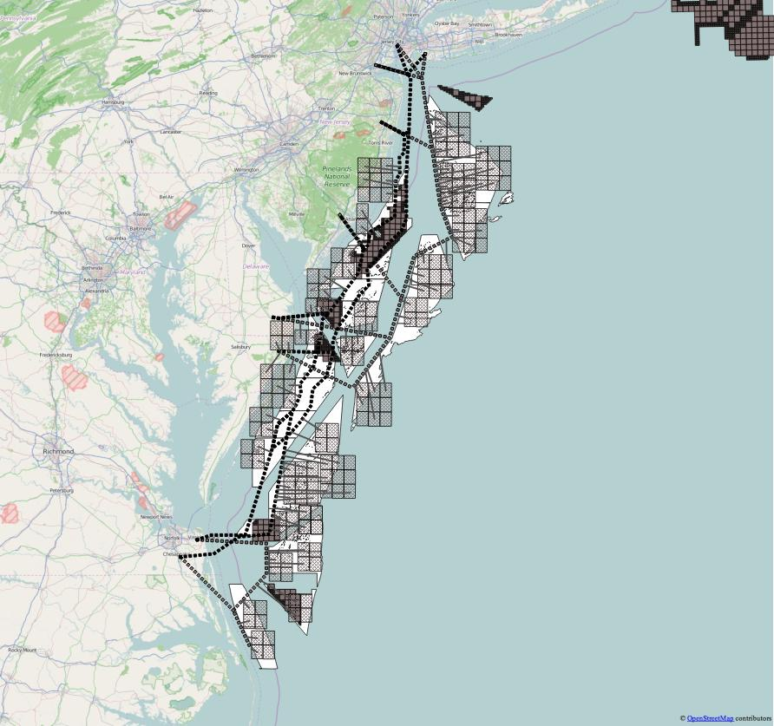
Approximate layout into 500 MW projects and “Backbone” transmission
The wind areas were connected to shore using two systems: AC radials for each project, and an HVDC “Backbone” to a smaller number of POIs. HVDC is shown here.
The lighter grey squares are the potential wind areas identified here, darker grey are already-designated wind energy areas (WEAs) designated by BOEM.
From EAI. Dissertation, Figure 3.6

Slide 7
Transmission Topologies
AC to Offshore Substation to AC to POI ashore (From EAI 2019 Figure 3)
AC to Offshore Substation to HVDC-VSC converter to backbone (From EAI 2019 Figure 5)

Slide 8
HVDC backbone or AC radials for each project?
Cost of AC system probably lower, also, if AC direct to show is managed by wind farm developer, so not concerned about 3rd party not having the backbone ready when my one wind farm is complete.
Losses in the HVDC-VSC systems are approximately 1%–2% lower than that in the AC system for a distance about 120 km from shore.
Other known technical advantages of HVDC: power flow is fully controlled, • AC faults are not transferred to the rest of the network, • there are no issues of cable charging currents, which for AC cables reduce the active power rating
More important, the converter stations allow control of each POI as if it were an individual generator — thus, easier to integrate this large new variable generation resource.

Slide 9
How much can we integrate?
Three studies: Apostolaki-Iosifidou et al (2019) on transmission topology for up to 80 GW resource; Archer et al (2017) on today’s realistic weather forecast for dispatch and realistic deviations, to test integration of up to 70 GW of that resource; Sameō (2017) et al to run dispatch and power flow model to test integration. (funded by US DOE DE-EE0005366, W. Kempton, PI)
Conservative integration criterion: “This question is addressed using only current power system practice, that is, no demand-side management [42], no large-scale battery or compressed air storage [36], no mixing of different types of additional renewable power generation (e.g., wind, solar, hydro), and no coupling to the heating and transportation sectors (as done for example by Ref. [7] were introduced.” (Archer et al 2017)
Also only current weather forecast — not coming methods with real-time data assimilation, rapid refresh, statistical bias corrections, and ensemble probabilistic forecasts. For comparison, also include “perfect forecast” (based on post-hoc knowledge).

Slide 10
How to Integrate from 0 to 70 GW of Offshore Wind
Left scale: GWs of 10-min synchronized reserves (battery or spinning reserves) needed.
Assumes current operating rules, AC from OSW, added transmission, but no new DSM or flex load. Assumes slow generators can only be adjusted based on day-ahead forcast.
* With today’s forecasts, need 8 GW reserves to integrate 70 GW of OSW.
* With perfect forecasts, ~1 GW reserves for 70 GW wind.
* Shoulder seasons better, but …
* July worse: with 15 GW reserves, OSW is limited to 35 GW in order to preserve 0% prob of generation shortfall.
from: Samaō et al 2017

Slide 11
Conclusions
We can add 35 GW of OSW to PJM and maintain reliability, conservatively assuming
Retain all current conditions and rules, but add traditional fast-ramp synchronous reserves
OR, integrate more OSW with any combination of…
more added capacity from DSM and storage,
change rules, eg. shorter notice for slow-rampers,
improve weather forecast (strong effect!),
control EV charging (& optionally discharging) rates. and/or
HVDC to shore, so each POI can be controlled as a separate “generator”

Slide 12
Takeaways
The PJM OSW resource is very large, it would add 44% to today’s PJM generation.
Yet, that can all be carried to shore using only today’s transmission technologies and equipment.
Choice of AC or HVDC technology; both were fully analyzed can can deliver all this power.
Additional POIs on land would be needed, not analyzed here.
Up to 35 GW capacity of OSW can be integrated with traditional means - just build more fast ramping reserves
But with rapid of growth of wind to West and to East, prudent to make adjustments as noted to more easily absorb more wind
Probably can integrate all 70 GW with a combination of multiple of the listed, more cost-effective means.

Slide 13
End
More information:
https://crew.udel.edu
Twitter @WillettKempton

